Slide 1
CISC 3130 Unix System Programming
Xiaolan Zhang
Spring 2013

Slide 2
Outline
Important course information
Objective
Roadmap
Requirement & policy
Brief history of GNU/Linux
GNU/Linux Architecture
Getting started
Log in, simple command, shell

Slide 3
You’ve written programs…
Lot of times, one can use existing tools to implement new functionalities
Real world applications are complicated:
generate input & output, or have GUI
communicate with other program (local or remote)
use multiple processes or threads for improved interactivities
Needs to be profiled/tested to improve performance

Slide 4
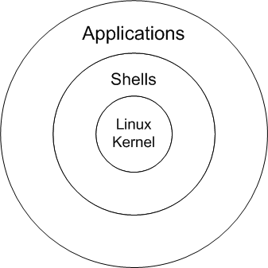
About this course
UNIX: time-sharing operating system, consisting of
kernel (program that controls and allocates system resources, file system)
Essential programs: compilers, editors, commands & utilities
Linux is a variation of Unix
programming environment is very similar

Slide 5
About this course
Many levels of programming:
Stronger awareness about
hardware and operating system
Low-level:
kernel programming
device driver
programming
High-level:
Web programming
System programming
Application programming
Notes:
5

Slide 6
Operating System, Kernel
operating system: two different meanings
the entire package consisting of central software managing a computer’s resources and all of accompanying standard software tools, such as command-line interpreters, graphical user interfaces, file utilities, and editors.
central software that manages and allocates computer resources (i.e., CPU, RAM, and devices).
kernel is often used as a synonym for second meaning

Slide 7
What is Operating System?
From app. programmer’s point of view:
O.S. manages hardware resources
O.S. provides user programs with a simpler interface, i.e. system calls
cnt=read(fd, buffer,nbytes)
getc() etc.
We will encounter OS concepts, inevitably.
User –level applications
System calls
Operating System
Physical machine interface
Hardware: processor(s), main memory, disks, printers, keyboard, display, network interface, etc.

Slide 8
Kernel Functionalities: Process scheduling
Managing one or more central processing units (CPUs),
Unix: a preemptive multitasking operating system
multiple processes (i.e., running programs) can simultaneously reside in memory and each may receive use of the CPU(s).
Preemptive: scheduler can preempt (or interrupt) a process, and resume its execution later => to support interactive responses
the processors are allowed to spend finite chunks of time (quanta, or timeslices) per process

Slide 9
Kernel Functionalities: Memory management
Manage physical memory (RAM) to be shared among processes in an equitable and efficient fashion
Virtual memory management:
Processes are isolated from one another and from the kernel, so that one process can’t read or modify the memory of another process or the kernel.
Only part of a process needs to be kept in memory, thereby lowering the memory requirements of each process and allowing more processes to be held in RAM simultaneously.
better CPU utilization, since it increases the likelihood that, at any moment in time, there is at least one process that the CPU(s) can execute.

Slide 10
Other OS functionalities …
The kernel provides a file system on disk, allowing files to be created, retrieved, updated, deleted, and so on.
Creation and termination of processes
Peripheral device: standardizes and simplifies access to devices, arbitrates access by multiple processes to each device
Networking: transmits and receives network packets on behalf of user processes.
Support system call interfaces: processes can request the kernel to perform various tasks using kernel entry points known as system calls.
Second part of this course: Unix system call API

Slide 11
Layers in UNIX/Linux System
Users
library
interface
Standard utility programs
(shell, editors, compilers)
POSIX 1003.2
System
call
interface
Standard library
(open, close, read, write, fork, etc)
POSIX
Unix/Linux kernel (process management, memory management, file system, I/O, etc)
Hardware (CPU, memory, disks, terminals, etc)

Slide 12
Goal of this course
Learn tools needed for develop application in GNU/Linux
A working understanding about UNIX
Basic commands, shell scripting
GNU tools for app. development
compiler, debugger, make, version control, library, testing/profiling tools
System calls provided in Unix:
to request services from operating system

Slide 13
Roadmap: a top-down approach
Get started topics
Basic concepts & useful commands
vi,emacs, sed, awk
Bash programming
Basic GNU Tools
Compiler chain, make, debugger (gdb)
Unix system calls
Advanced GNU Tools
Library, gcov, gprof, version control tools

Slide 14
Now let’s get started with some background information.

Slide 15
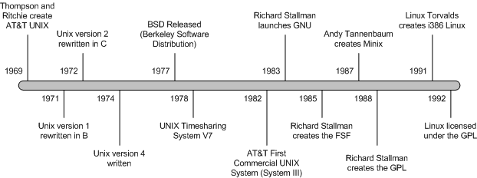
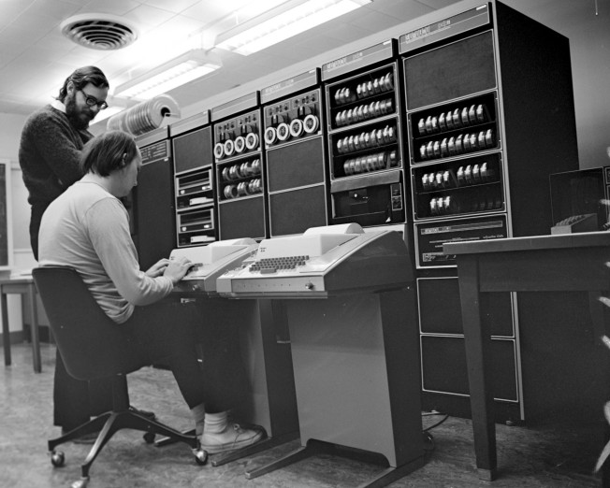
Timeline of Unix/Linux, GNU
1993
Windows NT
Windows 3X
Dennis
Ritchie
PDP-11
Ken Thompson

Slide 16
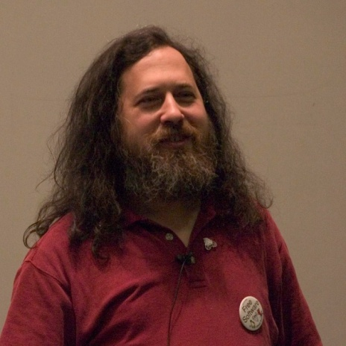
GNU history
GNU: GNU is Not Unix
Richard Stallman (author of Emacs, and many
other utilities, ls, cat, …, on linux)
1983: development of a free UNIX-
like operating system
Free Software Foundation (100s of
Programmers)
Free software:
freedom to run the program, for any purpose.
freedom to study how the program works and adapt it to your needs.
freedom to redistribute copies so you can help others.
freedom to improve the program and release your improvements to the public, so that everyone benefits.

Slide 17
GPL License
GNU General Public License is a free, copyleft license for software and other kinds of works…
“The licenses for most software and other practical works are designed to take away your freedom to share and change the works. By contrast, the GNU General Public License is intended to guarantee your freedom to share and change all versions of a program--to make sure it remains free software for all its users.”
Manual pages for commands include copyright info:
COPYRIGHT
Copyright © 2011 Free Software Foundation, Inc. License GPLv3+: GNU GPL version 3 or later <http://gnu.org/licenses/gpl.html>.
This is free software: you are free to change and redistribute it. There is NO
WARRANTY, to the extent permitted by law.

Slide 18

Linux history
Linus Torvalds
1991: “hobby” operating system for
i386-based computer, while study in Univ. of Helsinki
1996: Linux becomes a GNU software component
GNU/Linux: A fairer name than Linux?
“Most operating system distributions based on Linux as kernel are basically modified versions of GNU operating system. We began developing GNU in 1984, years before Linus Torvalds started to write his kernel. Our goal was to develop a complete free operating system. Of course, we did not develop all the parts ourselves—but we led the way. We developed most of the central components, forming the largest single contribution to the whole system. The basic vision was ours too. “ --- RMS

Slide 19
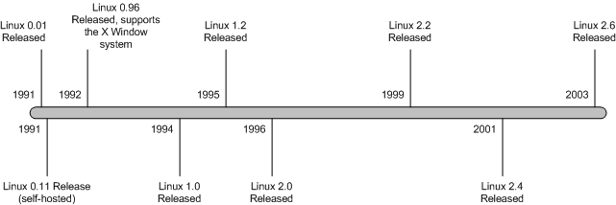
Linux kernel versions
Use “uname –a” to check system information
(including kernel version).

Slide 20
Linux version history
1.0: only supported single-processor i386-based computer
1.2 support for computers using processors based on the Alpha, SPARC, and MIPS architectures.
2.0: SMP support (symmetric multiple processors) and support for more types of processors
2.2: removed global spinlock, improved SMP support, support m68k and PowerPC architectures, new file systems (including read-only support for Microsoft’s NTFS)
2.4.0: support for ISA Plug and Play, USB, and PC Cards, PA-RISC processor, Bluetooth, Logical Volume Manager (LVM) version 1, RAID support, InterMezzo and ext3 file systems.

Slide 21
Linux version history
2.6.0 : integration of µClinux , PAE support, support for several new lines of CPUs, integration of ALSA , support for up to 2³² users , up to 2²⁹ process IDs, increased the number of device types and the number of devices of each type, improved 64-bit support, support for file systems of up to 16 terabytes, in-kernel preemption, support for the Native POSIX Thread Library (NPTL), User-mode Linux integration into the mainline kernel sources, SELinux integration into the mainline kernel sources, …
3.0 : 21 July 2011. the big change was, "NOTHING. Absolutely nothing.” "...let's make sure we really make the next release not just an all new shiny number, but a good kernel too." , released near the 20th anniversary of Linux

Slide 22
Understanding uname
$ uname -a
Linux storm.cis.fordham.edu 3.6.11-1.fc16.x86_64 #1 SMP Mon Dec 17 21:29:15 UTC 2012 x86_64 x86_64 x86_64 GNU/Linux
Kernel name: Linux:
Hostname
Kernel release: 3.6.11-1.fc16.x86_64
Kernel version: #1 SMP Mon Dec 17 21:29:15 UTC 2012
Machine hardware name: x86_64 (AMD64 instruction set)
Processor:x86_64
Operating system: GNU/Linux

Slide 23
Unix Standardization
Different implementations of Unix diverged:
Different meaning for command options
System calls syntax and sementatics
POSIX, "Portable Operating System Interface", is a family of standards specified by IEEE for maintaining compatibility between Unix systems.
C library level, shell language, system utilities and options, thread library
currently IEEE Std. 1003.1-2004
POSIX for Windows:
Cygwin provides a largely POSIX-compliant development and run-time environment for Microsoft Windows.

Slide 24
Single Unix Specification
1990: X/Open launches XPG3 Brand. OSF/1 debuts.
1993: Novell transfers rights to "UNIX" trademark and Single UNIX Specification to X/Open.
1994: X/Open introduces Single UNIX Specification, separating the UNIX trademark from any actual code stream
1995:X/Open introduces UNIX 95 branding program for implementations of Single UNIX Specification.
1996 : Open Group forms as a merger of OSF and X/Open.

Slide 25
X/Open => Open Group
1997: Open Group introduces Version 2 of Single UNIX Specification, including support for realtime, threads and 64-bit and larger processors.
1998: Open Group introduces UNIX 98 family of brands, including Base, Workstation and Server. First UNIX 98 registered products shipped by Sun, IBM and NCR.
1999: Open Group and IEEE commence joint development of a revision to POSIX and the Single UNIX Specification.
2001: Version 3 of the Single UNIX Specification unites IEEE POSIX, The Open Group and the industry efforts.

Slide 26
Today’s Unix Systems
To be an officially Unix system, need to go through certification based on the Single Unix Specification
Registered Unix systems: AIX, HP/UX, OS X, Reliant Unix, ….
Linux and FreeBSD do not typically certify their distributions, as the cost of certification and the rapidly changing nature of such distributions make the process too expensive to sustain.

Slide 27
Outline
Important course information
Objective
Roadmap
Requirement & policy
Brief history of GNU/Linux
GNU/Linux Architecture
Getting started
Shell
File system, file

Slide 28
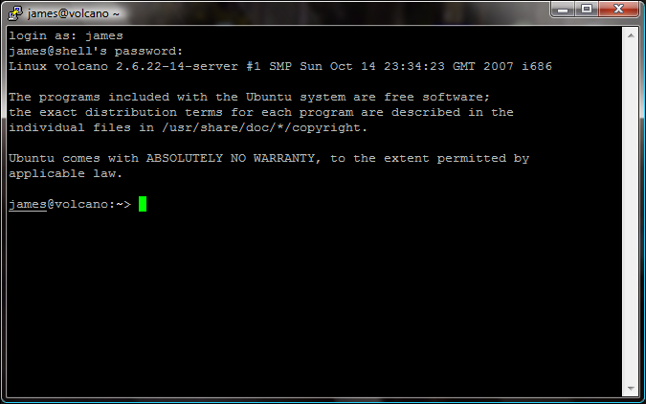
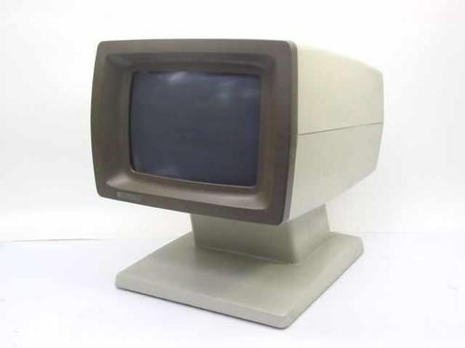
A Quick Start
Terminal
PuTTy, a telnet/ssh client
a free and open source terminal emulator application
a window in your desktop that works like old time terminal
Enter your ID and password

Slide 29
Your first encounter: shell
Shell: a special-purpose program, command line interpreter, read commands typed by a user and execute programs in response to entered commands
Many different shells:
Bourne Shell (sh): oldest,
I/O redirection, pipelines, filename generation (globbing), variables, environment variables, command substitution, background command execution, function
C Shell (csh): syntax of flow-control similar to C, command history, command-line editing, job control, aliases
Korn Shell (ksh): “csh”, compatible with sh
Bourne again Shell (bash): GNU’s reimplementation of Bourne shell, supports features added in C shell, and Korn shell

Slide 30
Check/Change Login Shell
To check the shell you are using
echo $SHELL
echo $0
login shell: default shell for a user, specified in /etc/passwd
To change your login shell, use command
chsh

Slide 31
Shell: interactive mode
A shell session (a dialog between user and shell)
Displays a prompt character, and waits for user to type in a command line
Prompt depends on shell: sh, ksh, bash: $ csh: % tcsh: >
May be customized (with current directory, host, ...)
On input of a command line, shell extracts command name and arguments, searches for the program, and runs it.
When program finishes, shell continues to step 1
The loop continues until user types “exit” or “ctrl-d” to end

Slide 32
UNIX command line
Command name and arguments:
command [ [ - ] option (s) ] [ option argument (s) ] [ command argument (s) ]
Command arguments are mostly file or directory names
cp prog1.cpp prog1.cpp.bak
Options: used to control behavior of the command
head -20 lab1.cpp
wc –w lab2.cpp // count how many words
Some options come with option argument
sort –k 1 data.txt
// use the first column of data.txt as the key to sort

Slide 33
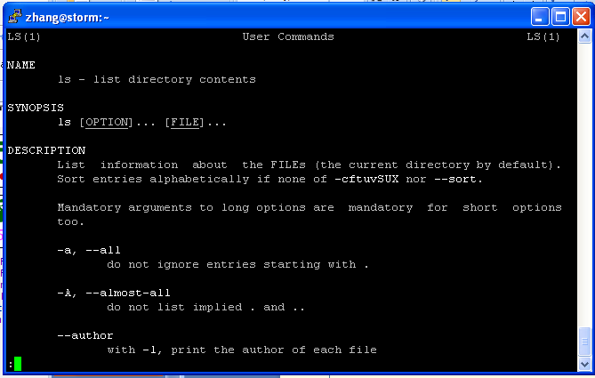
The most important command !!!
man: displaying online manuals
Press q to quit, space to scroll down, arrow keys to roll up/down
man ls

Slide 34
Correcting type mistakes
Shell starts to parse command line only when Enter key is pressed
Delete the whole line (line-kill): C-u
Erase a character: C-h or backspace key
Many more fancy functionalities:
Auto-completion: press Tab key to ask shell to auto-complete command, or path name
History (repeat command): use arrow (up and down) keys to navigate past commands
…

Slide 35
Shell: batch/scripting mode
In batch mode, shell can interpret and execute shell scripts
#!/bin/bash
# count number of files/directories in curr. directory
ls -l | wc -l
Shell constructs:
variables,
Loop and conditional statements
I/O commands (read from keyboard, write to terminal)
Function, arrays …

Slide 36
Outline
Important course information
Objective
Roadmap
Requirement & policy
Brief history of GNU/Linux
GNU/Linux Architecture
Getting started
Shell
File systems, file,

Slide 37
Unix File
Files: store information
a sequence of 0 or more bytes containing arbitrary information
What's in a filename?
Case matters, no longer limited to 14 chars
Special characters such as -, spaces are allowed, but you shouldn’t use them in filename
Can you think of the reason ?
Dot files are hidden, i.e., normally not listed by command ls
To display all files, including hidden files, use ls -a

Slide 38
What’s in a file ?
So far, we learnt that files are organized in a hierarchical directory structure
Each file has a name, resides under a directory, is associated with some admin info (permission, owner)
Contents of file:
Text (ASCII) file (such as your C/C++ source code)
Executable file (commands)
A link to other files, …
Virtual file:
/proc: a pseudo-filesystem, contains user-accessible objects on runtime state of kernel and executing processes
To check the type of file: “file <filename>”

Slide 39
File Viewing Commands
cat: concatenate files and display on standard output (i.e., the terminal window)
cat [option] … [file] …
cat proj1.cpp
cat proj1.cpp proj2.cpp
cat –n proj1.cpp // display the file with line #
More: file perusal filter (i.e., displaying file one screen at a time)
more proj1.cpp
head, tail: display the beginning or ending lines of a file
tail -f output // display the file, append more lines as the file grows
[ ] means the argument is optional
… means there can be multiple
arguments of this type

Slide 40
File manipulation commands
rm: remove one or multiple files or directories
rm [option] … FILE …
rm temp
rm temp1 temp2
Wildcards (metacharacter) can be used in command line
Letter * matches with any string
rm *.o: remove all .o files
?: match any one character
[abc]: match with letter a or b or c
rm –r: remove directories and their sub-dirs recursively
rm –i : confirm with user before removing files

Slide 41
File manipulation commands (2)
cp: copy file or directory
cp [OPTION] SOURCE DESTINATION
To make a backup copy of your program before dramatic change
cp proj1.cpp proj1.cpp.bak
To make a backup copy of a whole directory
cp –r lab1_dir lab1_dir_backup
-R, -r, --recursive: copy directories recursively

Slide 42
File manipulation commands (3)
mv: move (rename) files/directories
mv [OPTION] SOURCE DEST
Rename SOURCE to DEST
mv proj1.cpp lab1.cpp
mv [OPTION]… SOURCE… DIRECTORY
Move SOURCE to DIRECTORY
mv lab1.cpp lab2.cpp CISC3130

Slide 43
Hierarchical file system
Directory: a file that can hold other files
Advantages of hierarchical file system:
Files can have same names, as long as they are under different directories
Easier for protection
Organized files
/ (root)
dev
bin
home
etc
lib
cdrom
tty24
group
passwd
staff
zhang

Slide 44
Absolute pathname, path
/ (root)
dev
bin
home
etc
lib
cdrom
tty24
passwd
staff
zhang
Pathname of a file/directory: location of file/directory in the file system
How do you tell other where your prog. Is located ?
Absolute pathname: path name specified relative to root, i.e., starting with the root (/)
e.g., /home/staff/zhang
What’s the absolute pathname for the “passwd” file?

Slide 45
Home directory
Every user has a home directory created for him/her
When you log in, you are in your home directory
In home directory, a user usually has permission to create files/directories, remove files ..
~ to refer to current user’s home directory
~username to refer to username’s home directory

Slide 46
Current directory & Relative Pathname
Tiring to specify absolute pathname each time
To make life easier: working directory
User can move around the file system, shell remembers where the user is (i.e., current directory)
To check your current directory, use command:
pwd
Notes:
46

Slide 47
Getting around in the file system
To create a subdirectory:
mkdir [option]… directory…
cd
mkdir CISC3130
cd CISC3130
mkdir lab1
To remove a directory:
rmdir [option]… directory…
Report failure if directory is not empty
Can use rm –rf to remove non-empty directory

Slide 48
Command for change current directory (move around)
cd [directory]
[zhang@storm Work]$ cd
[zhang@storm ~]$ pwd
/home/staff/zhang
[zhang@storm ~]$ cd Work
[zhang@storm Work]$ pwd
/home/staff/zhang/Work
[zhang@storm Work]$ cd ..
[zhang@storm ~]$ pwd
/home/staff/zhang
[zhang@storm ~]$
48
Notes:
48

Slide 49
Relative pathname
Absolute pathname: specified relative to root
Relative pathname: specified relative to current directory
. (current directory), .. (parent directory, one level up)
If current directory is at /home/staff/zhang, what is the relative pathname of the file passwd?
../../../etc/passwd: go one level up, go one level up, go one level up, go to etc, passwd is there
/ (root)
dev
bin
home
etc
lib
cdrom
tty24
passwd
staff
zhang
Notes:
49

Slide 50
Relative pathname
For all commands that take file/directory name as arguments, you can use pathnames of the file/directory
Example:
cd /home/staff/zhang/public_html
pico CISC3130/index.html
cd .. (go up one level to parent directory)
cp ../prog2.cpp prog2.cpp
Notes:
50

Slide 51
Getting around in the file system
ls: list directory contents
ls [OPTION] … [FILE]
ls: list files/directories under current directory
ls –l: long listing,
[zhang@storm CISC1600]$ ls -l
total 59180
-rw-r--r-- 1 zhang staff 509952 Sep 7 13:02 3_types.ppt
-rw-r--r-- 1 zhang staff 593408 Sep 14 23:38 4_computation.ppt
-rw-r--r-- 1 zhang staff 1297 Sep 2 12:18 account.html
-rw-r--r-- 1 zhang staff 3304448 Nov 7 18:24 ArrayVector1.ppt
drwxr-xr-x 2 zhang staff 4096 Dec 8 22:36 Codes

Slide 52
Long listing
To get more information about each file
[zhang@storm Demo]$ ls -al
total 32
drwxr-xr-x 5 zhang staff 4096 2008-01-16 16:01 .
drwxr-xr-x 41 zhang staff 4096 2008-01-16 16:01 ..
drwxr-xr-x 2 zhang staff 4096 2008-01-16 15:55 CCodes
-rw-r--r-- 1 zhang staff 38 2008-01-16 16:01 .HiddenFile
-rw-r--r-- 1 zhang staff 53 2008-01-16 15:57 README
drwxr-xr-x 2 zhang staff 4096 2008-01-16 15:55 SampleCodes
drwxr-xr-x 4 zhang staff 4096 2008-01-16 15:56 ShellScriptes
Total disc space taken in blocks (1024 Byte)
User name of the owner and its group
d means
directory
Who has permission to read/write the file

Slide 53
Long listing explained
drwxr-xr-x 4 zhang staff 4096 2008-01-16 15:56 ShellScriptes
field 1
1st Character: specifies the type of the file.
- normal file, d directory, s socket file, l link file
next 9 characters – File Permissions
field 2: specifies the number of links for that file
field 3: specifies owner of the file
field 4: specifies the group of the file
field 5: specifies the size of file
field 6: date and time of last modification of the file
field 7: file name

Slide 54
File permissions
drwxr-xr-x 4 zhang staff 4096 2008-01-16 15:56 ShellScriptes
Each file is associated with permission info.
Differentiate three type of users: owner user, users from same group as owner, others
Three type of access: - in the field means no permission
Read (r): use “cat” to open a file to read, use “ls” to list files/directories under a directory
Write (w): modify the contents of the file, create/remove files from the directory
Execute (x): execute the file, or “cd” or “search” the directory for file
Trying to list other’s directory
[zhang@storm ~]$ ls ../roche/
ls: cannot open directory ../roche/: Permission denied

Slide 55
User and Group
Each user has unique login name (user name), and corresponding numeric ID
Group id, home directory, login shell:
Stored in file /etc/passwd
Groups: each user can belong to multiple groups
For collaboration …
Group name, group id, user list info stored in /etc/group
Superuser
ID: 0, username: root
Bypass all permission checks …

Slide 56
More to play with
who: show who is logged on
who am I
write: write to another user’s terminal (IMS?)
which: show the full path name of a command
$ which bash
/bin/bash
How does shell find a command ?
Environment variable PATH stores a list of paths to search for programs: “set | grep PATH” or “echo $PATH”, “set” to show all variable settings
PATH=$PATH:$HOME/bin:.
Built-in commands: history, set, echo, etc.
mail: send email from command line
mail -s “graded project” zhang < proj1.cpp

Slide 57
Summary
Unix, a time-sharing operating system
Operating system
a program that sits between hardware and user
manages resources (CPU, memory, disk, network connection) and present user interface to user
Unix programming environment, i.e., platform
the layered view

Slide 58
Summary (cont’d)
PuTTy emulates a terminal
Shell: a command line interface
Engage in dialog (a session with user)
What’s in a command
Name, and arguments
Hierarchical file system: file and directory
Commands for working with file system

